Slide 1

Capstone Project

Slide 2



Personal BACKGROUND
(Name, Past Experience, Qualification, Career Summary)
Name : Vijayaragavan T
Past Experience : Fresher
Qualification : B.Tech Information Technology
Career Summary :
Completed B.Tech IT from Sri Venkateswara College of Engineering.
Completed Schooling from Shree Niketan.
www.collaberadigital.com

Slide 3


Key Takeaways/Learnings from the Program (HTD)
Fundamentals of Java and MySQL.
Junit testcases for testing.
An overview of Software Development Life Cycle and Agile methodologies.
Developing Rest Application using Java and Spring Boot.
API testing with Postman.
Critical Thinking and Time Management.
Generative AI Impacts on Development.
Sonarcube for improving code quality.

Slide 4

Problem Statement of the Capstone Project
To Develop an Online Shopping Application using Java and Spring Boot.
This Application provides functionality like user details, Helps to browse the products and to keep track of all the past order details as well as helps user to manage their shopping cart information.

Slide 5
Why Spring Boot ?
Spring Boot projects are built on Spring Framework which helps in developing Monolithic and Micro-Service applications.
By using Spring Boot rapid development and integration can be done at ease.
Why Java ?
Java is used because of its Object-Oriented principles and the preexisting libraries makes the development faster and easier.

Slide 6

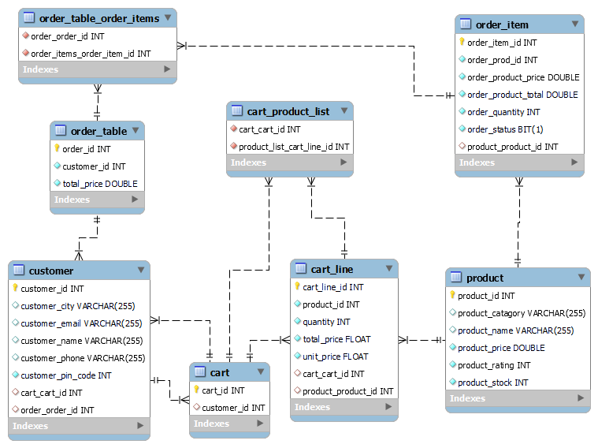
Entity Diagram

Slide 7

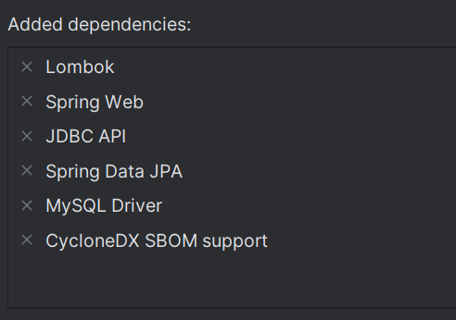
Dependencies Needed for the project

Slide 8
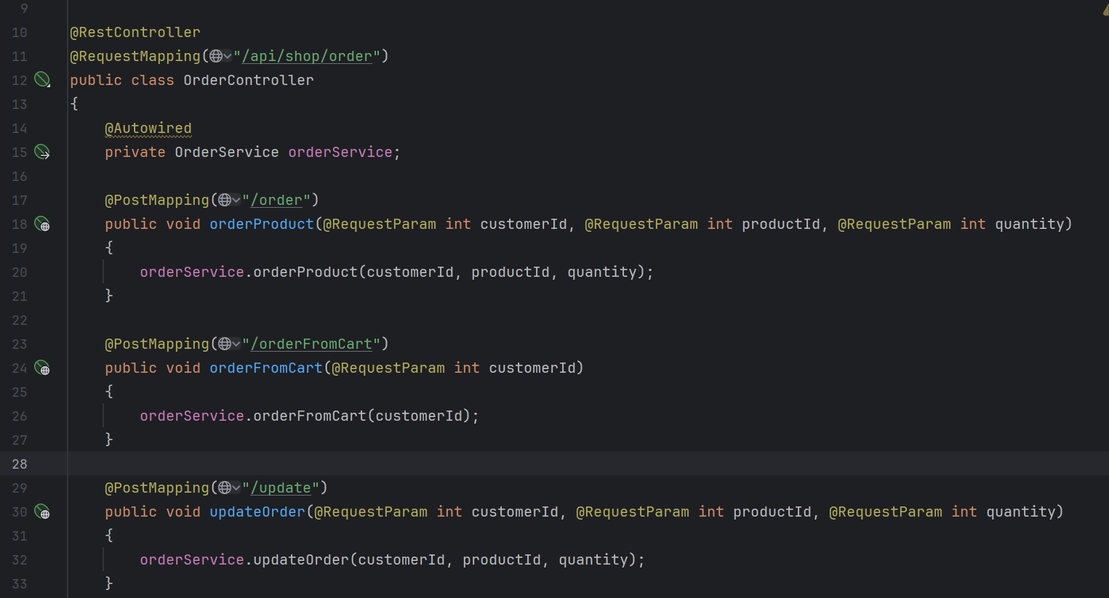
Important areas of the Project with screenshots
Separate Endpoints for each functionalities makes it easier to understand

Slide 9
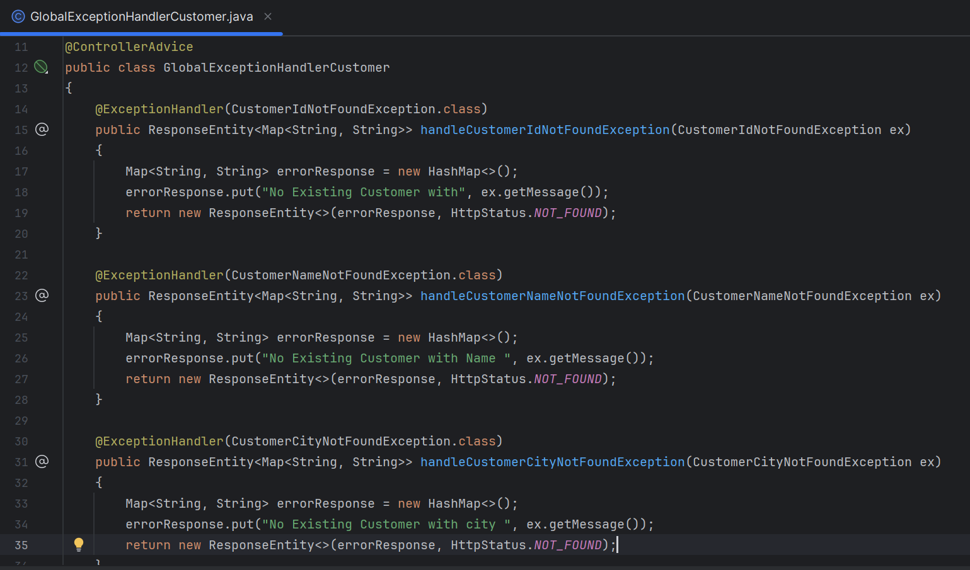
Important areas of the Project with screenshots
A Global Exception Handler class for handling the exceptions of each module.

Slide 10
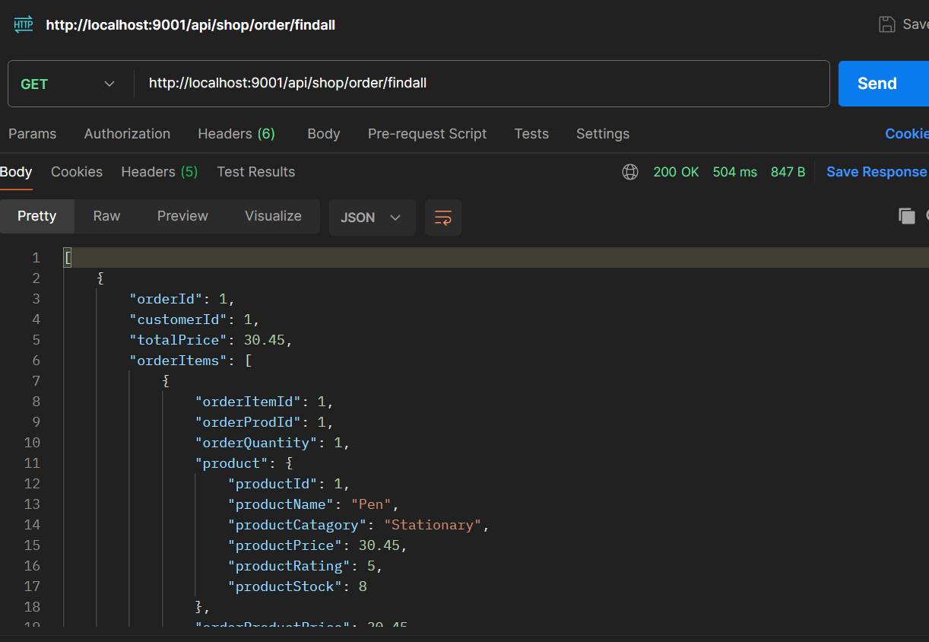
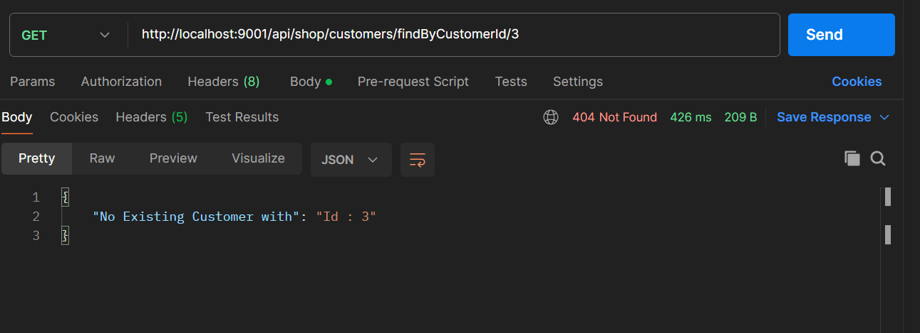
Important areas of the Project with screenshots
Sample Outputs :

Slide 11
Conclusion
The Online Shopping Application built using Spring Boot serves its purpose to the customers through various endpoints.
The Java based framework makes it more flexible and by utilizing the Spring Boot it makes more easier for the customer to maintain the corresponding application by themselves.

Slide 12
Thank You

